Slide 1
Selfish, Stubborn & GHOST Mining
Mohammed Z. Guniem & ESSANDOH RAYMOND

Slide 2
Blockchain Mining
3 main constraints:
- Mining Power.
- Network Power.
- Number of miners.
Simulation environment
- 100 miners in total.
- Total mining power of 100
- Total network power of 100

Slide 3
Analysis of mining power Simulation nr. 1 - Setup
Studying the effect of an increasing mining power of just one selfish miner.
Having:
- 100 in total mining power and 100 miners.
- 99 honest miners
- 1 selfish miner
- Network power is random in case of blockchain forks.
We start the selfish mining power at 0% and the honest mining power at 100%.
We run the simulation for 60 steps, and at each step:
- Increasing the selfish mining power by 1.
- Decreasing the honest mining power by 1.

Slide 4
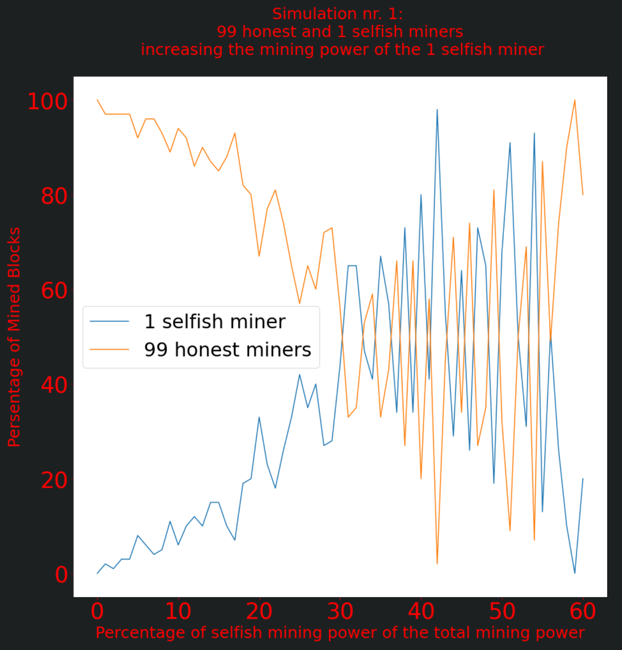
Analysis of mining power Simulation nr. 1 – Results & Analysis
< 25% selfish mining power:
- Total selfish profit is more likely to be less than total honest profit
>= 25% selfish mining power:
- Profit of the selfish miner is highly competitive with the total honest profit generated by the other 99 honest miners.
But does that mean selfish mining is a good strategy?
- 1 selfish miner was able to claim from 0% to 40% of total profit for a mining power less than 25%.

Slide 5
Analysis of mining power Simulation nr. 2 - Setup
Studying the effect of an increasing number of selfish miners where all individual honest and selfish miners have equal mining power.
Having:
- 100 in total mining power and 100 miners.
- Every miner always has an equal mining power of 1.
- Network power is random in case of blockchain forks.
We start the selfish mining power at 0% (0 selfish miners)
And the honest mining power at 100% (100 honest miners).
We run the simulation for 60 steps, and at each step:
- Increasing the selfish mining power by increasing the number of selfish miners by 1.
- Decreasing the honest mining power by decreasing the number of honest miners by 1.

Slide 6
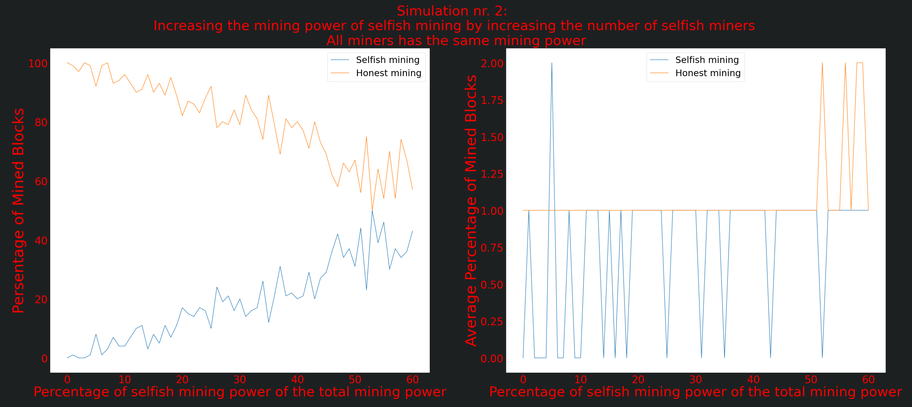
Analysis of mining power Simulation nr. 2 – Results & Analysis
From 0% (0 selfish miners) to 50% (50 selfish miners) selfish mining power
- Increasing selfish profit
From 100% (100 honest miners) to 40% (40 honest miners) honest mining power
- Decreasing honest profit
Stable average profit of an honest miner at 1%.
- Good/Fair distribution of profit among miners.
Instable average profit of a selfish miner mostly between 0% and 1%.
Unfair distribution of profit among selfish miners.
Small exceptions might appear, like at 5% mining power.

Slide 7
Analysis of network power Simulation nr. 3 - Setup
Studying the effect of an increasing network power of just one selfish miner.
Having:
- 100 in total network power and 100 miners.
- 99 honest miners.
- 1 selfish miner.
- Network power is weighted random.
- Mining power is equal for all miners to isolate its effect on mining.
We start the selfish network power at 0% and the honest network power at 100%.
We run the simulation for 100 steps, and at each step:
- Increasing the selfish network power by 1.
- Decreasing the honest network power by 1.

Slide 8
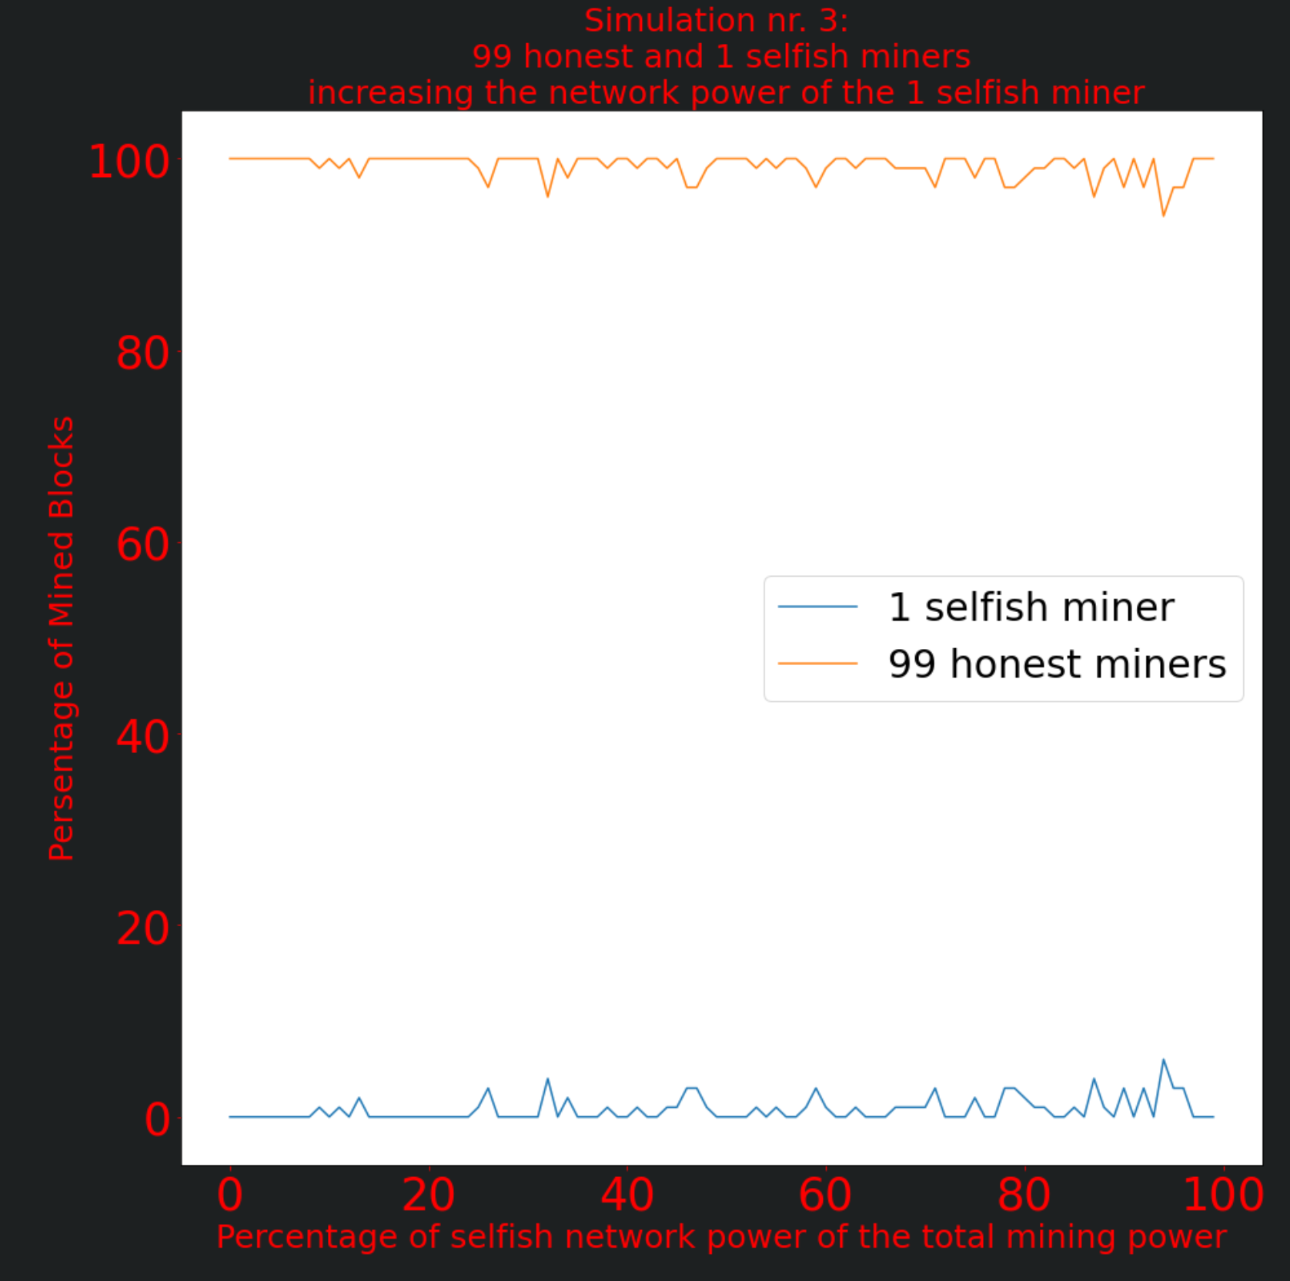
Analysis of network power Simulation nr. 3 – Results & Analysis
Max. achieved profit percentage is 5% for the one selfish miner.
- no matter how big of a network power the selfish miner has.
A small increase in profit when the 1 selfish miner owns more than 80% of the total network power.
- Not realistic, and still under 5% in profit.
Should the selfish miner switch to honest mining?
- Honest mining is a good strategy for a group of honest miners, and miners with low network power
- Selfish mining is a good strategy for a lonely miner with high network power, but not realistic and hard to get hold on such large amount of network power.

Slide 9
Analysis of network power Simulation nr. 4 - Setup
Studying the effect of an increasing number of selfish miners where all individual honest and selfish miners have equal network power.
Having:
- 100 in total network power and 100 miners.
- Every miner always has an equal network power of 1.
- Network power is weighted random.
- Mining power is equal for all miners to isolate its effect on mining.
We start the selfish network power at 0% (0 selfish miners)
And the honest network power at 100% (100 honest miners).
We run the simulation for 100 steps, and at each step:
- Increasing the selfish network power by increasing the number of selfish miners by 1.
- Decreasing the honest network power by decreasing the number of honest miners by 1.

Slide 10
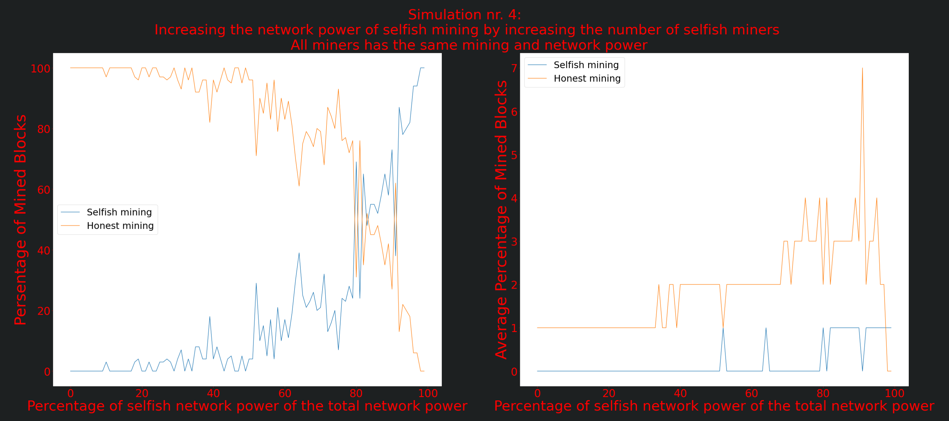
Analysis of network power Simulation nr. 4 – Results & Analysis
Under 80% network power for selfish miners.
- Less profitable selfish mining
At around 80% to 85%
- High competition between selfish and honest mining.
Selfish mining is more profitable when:
- Selfish miners have more than 90% of network power together in total.
However, for an average miner it is most likely better to be an honest miner
- Since the average profit made by honest miners is most of the time higher than it is for those selfish miners.

Slide 11
Analysis of Selfish Mining with the GHOST strategy Simulation nr. 5 - Setup
Studying the effect of GHOST mining while increasing the selfish mining and network power by increasing the number of selfish miners and decreasing the number of honest miners.
Greedy Heaviest-Observed Subtree, GHOST
Having:
- 100 in total network power, 100 in total mining power, and 100 miners.
- Every miner always has an equal network and mining power of 1.
- Network power is weighted random.
- Mining and network power is equal for all miners to isolate its effect on mining and observe the effect of GHOST mining alone.
We start the selfish network and mining power at 0% (0 selfish miners)
And the honest network and mining power at 100% (100 honest miners).
We run the simulation for 100 steps, and at each step:
- Increasing the selfish network and mining power by increasing the number of selfish miners by 1.
- Decreasing the honest network and mining power by decreasing the number of honest miners by 1.

Slide 12
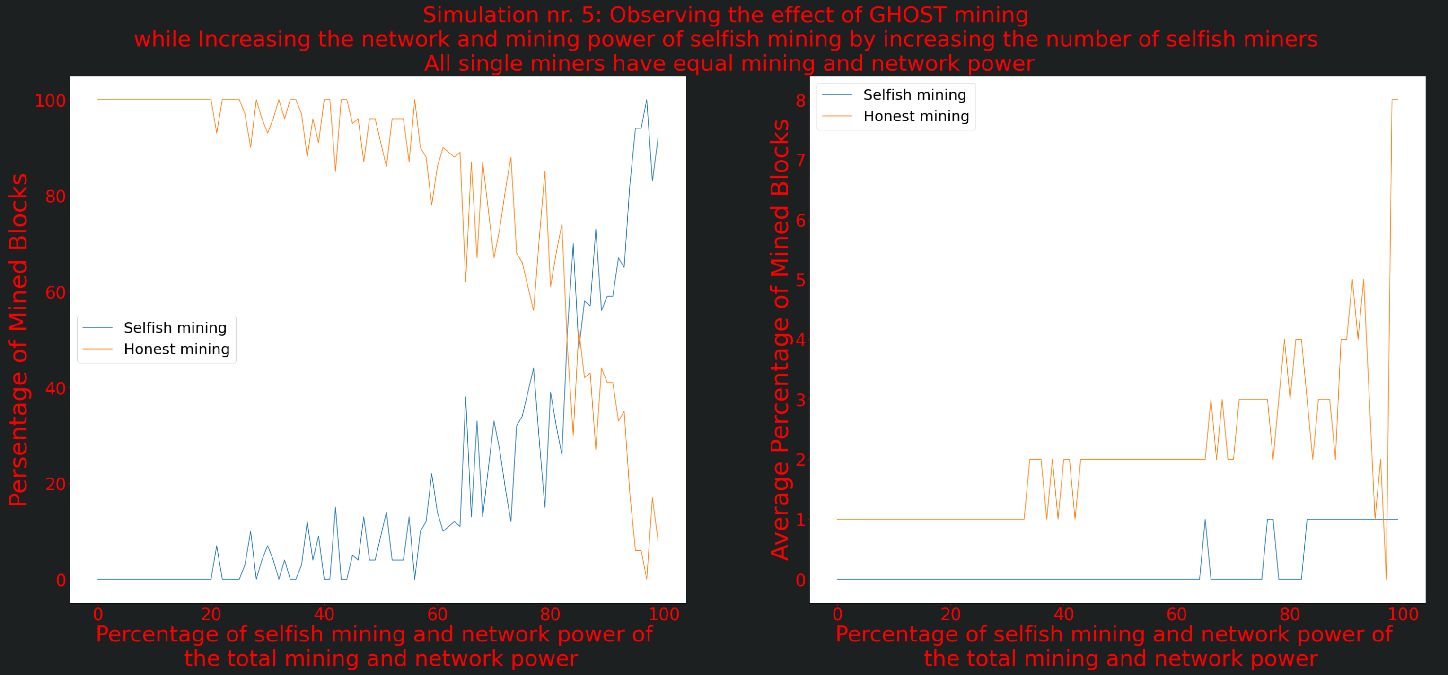
Analysis of Selfish Mining with the GHOST strategy Simulation nr. 5 – Results & Analysis
Selfish miners following the GHOST strategy have to get hold on more than 80% of both network and mining power to be start making more profit then honest miners.
On average, single honest miners makes more profit than their counter GHOST selfish miners, as shown in the right plot on the right side.

